Slide 1

Data structures

Slide 2
Queue
1
The queue structure corresponds to a plain, real-life queue.

Slide 3
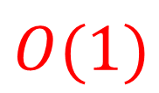
Definition
Queue is a First In First Out (FIFO) / Last In Last Out (LILO) data structure that supports three operations:
}
Push : which adds an element to the back of the queue.
$$O(1)$$
Pop : which removes an element from the front of the queue.
Front : which retrieves the element at the front without removing it.
We can describe queue as N person in bank queue the first one come, first one served

Slide 4



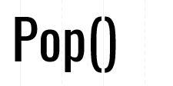


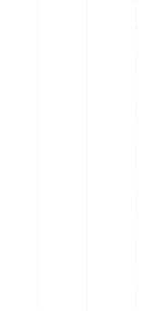
Structure
7
5
14
1
6
⬅ front
⬅ front

Slide 5
Functions
Function | Meaning
empty() | Returns whether the queue is empty.
Size() | Returns the size of the queue
front() | Returns a reference to the front element of the queue
push(g) | Adds the element ‘g’ at the top of the queue
pop() | Deletes the front element of the queue

Slide 6
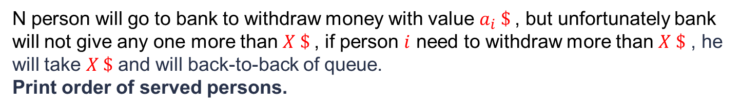
Practice
N person will go to bank to withdraw money with value $a_{i} \$$, but unfortunately bank will not give any one more than $X \$$, if person $i$ need to withdraw more than $X \$$ , he will take $X \$$ and will back-to-back of queue.
Print order of served persons.
input
5 10
8 12 6 11 9
Output
1 3 5 2 4

Slide 7
Stack
2
The stack is a data structure that contains an ordered lists of values.

Slide 8
Definition
Stack is a Last In First Out (LIFO) / First In Last Out (FILO) data structure that supports three operations:
}
Push : which adds an element to the top of the stack.
$$O(1)$$
Pop : which removes an element from the top of the stack.
Top : which retrieves the element at the top without removing it.
We can describe stack as N dishes we must take the last dish first, we can’t take first one firstly

Slide 9







Structure
12
⬅ top
3
⬅ top
⬅ top
8
⬅ top
5
⬅ top

Slide 10
Functions
Function | Meaning
empty() | Returns whether the Stack is empty.
Size() | Returns the size of the stack
Top() | Returns a reference to the top element of the stack
push(g) | Adds the element ‘g’ at the top of the stack
pop() | Deletes the top element of the stack

Slide 11
Deque
3
Double-ended queues are sequence containers.

Slide 12
Definition
Deque double-ended queues are sequence containers with the feature of expansion and contraction on both ends. They are similar to vectors, but are more efficient in case of insertion and deletion of elements. Support all vector functionality and additional four functions:
Push_front : which adds an element to the front of the deque.
Push_back : which adds an element to the back of the deque.
Pop_front : function is used to pop or remove elements from a deque from the front.
Pop_back : function is used to pop or remove elements from a deque from the back.

Slide 13







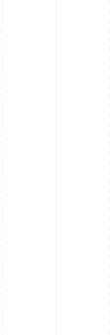
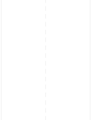
Structure
⬅ front
⬅ front
⬅ front
⬅ front
⬅ front
9
12
7
5
6
⬅ back
⬅ back
⬅ back

Slide 14
Functions
Function | Meaning
empty() | Returns whether the Stack is empty.
Size() | Returns the size of the stack
push_front() | push elements into a deque from the front.
push_back() | push elements into a deque from the back.
Pop_back() | pop or remove elements from a deque from the back.
Pop_front() | or remove elements from a deque from the front

Slide 15
Number theory

Slide 16
Prime Numbers
1
Prime numbers are numbers that have only 2 factors

Slide 17
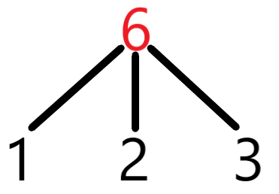
Definition
Prime numbers are the numbers that have only two factors, that are, 1 and the number itself.
Consider an example of number 5, which has only two factors 1 and 5. This means it is a prime number.
Let's take another example of the number 6:

Slide 18

Algorithm 1 (Naive solution)
Any number N may be divided by any number less than $\sqrt{N}.$
Proof :
$\sqrt{N} ∗ \sqrt{N}$ = ${\sqrt{N}}^{2}=N$
Bool is prime (int x ) {
}
}
If( x <= 1) { return false ;} //corner case
for ( int i = 2 ; i * i <= x ; ++i) {
if( x % i == 0 ) { return false ;}
}
$$O(\sqrt{N})$$
return true ;

Slide 19









Algorithm 2 (Sieve of Eratosthenes)
We will reverse our concept, if $N$ is prime, $N ∗ j$not prime.
We mark whole the array white (True) , and if current number white, we will mark all multiplications as False.
1 | 2 | 3 | 4 | 5 | 6 | 7 | 8 | 9 | 10 | 11 | 12
4
6
6
8
9
10
10
12
12
$$O(N ∗ \log{N} ∗ \log{N})$$

Slide 20
Algorithm 2 (Sieve of Eratosthenes)
Void Sieve of Eratosthenes (int x ) {
}
bool prime [ x + 1 ]; // our array for primes
memset(prime, true, sizeof(prime)); // fill the array with value true
for (int p = 2 ; p * p <= x ; p++){
}
if ( prime [ p ] == true ) { // not changed it’s prime
}
for (int i = p * p; i <= x; i += p){ // mark all multiples as false
prime[i] = false;
}

Slide 21

Prime Factorization
2
For every number $(n>1)$, there is a unique prime factorization .

Slide 22

Definition
Any number $n$ can be represented as multiplication of primes.
$$n = {P_{1}}^{α_{1}} .{ P_{2}}^{α_{2}}.{{ P}_{3}}^{α_{3}}…… {P_{k}}^{α_{k}}$$
For example :
$$84= 2^{2} . 3^{1} . 7^{1}$$

Slide 23
Algorithm 1 (similar to Sieve of Erastosthenes.)
Void primeFactors (int x ) {
}
Int c = 2; // the denominator
While( x >1){
}
If ( x % c == 0 ){
cout<<c<<‘ ‘ ;
x/= c;
}
else{
c++; // when c = 4 will skip because all 2’s has been divided
}
$$O(N)$$

Slide 24
Euclid’s Algorithm
3
The greatest common divisor of numbers.

Slide 25
Definition
The greatest common divisor (GCD), also called the greatest common factor, of two numbers is the largest number that divides them both.
For instance, the greatest common factor of 20 and 15 is 5, since 5 divides both 20 and 15 and no larger number has this property.
$$a = {P_{1}}^{α_{1}} .{ P_{2}}^{α_{2}}.{{ P}_{3}}^{α_{3}}…… {P_{k}}^{α_{k}}$$
$$GCD(A,B) = {P_{1}}^{{min⁡(α}_{1},β_{1})} .{ P_{2}}^{{min⁡(α}_{2},β_{2})}.{{ P}_{3}}^{{min⁡(α}_{3},β_{3})}… {P_{k}}^{{min⁡(α}_{k},β_{k)}}$$

Slide 26



Example
$$84= 2^{2} . 3^{1} . 7^{1}$$
$$231= 3^{1} . 7^{1}.{11}^{1}$$
$$GCD\left(84,231\right)= 2^{\min\left(2,0\right)} .{ 3}^{\min\left(1,1\right)}.7^{\min\left(1,1\right)}.{11}^{min⁡(0,1) }$$
$$2^{0} . 3^{1} .{ 7}^{1}{ . 11}^{0}=21$$

Slide 27
Euclidean Algorithm
int gcd (int a , b ) {
return b;
}
int gcd ( int a , int b){
If ( b == 0 ) { return a ; }
Else{
return gcd( b , (a % b) );
}
}
int R; //reminder
While ( (a%b) > 0 ) {
R = ( a % b );
a = b ;
b = R;
}

Slide 28
Problems
https://www.codechef.com/START27C/problems/PRODUCT
https://atcoder.jp/contests/abc084/tasks/abc084_d
https://codeforces.com/problemset/problem/26/A
28

Slide 29
THANKS!
Any questions?

